Slide 1

Problem Solving by Searching
Prepared by
Lec Shekh. Md. Saifur Rahman
PREPARED BY
SWAPNIL BISWAS

Slide 2
Problem-Solving Agents
Intelligent agents can solve problems by searching a state space
State-space Model
The agent’s model of the world
Usually a set of discrete states
E.g., in driving, the states in the model could be towns/cities
Goal State(s)
A goal is defined as a desirable state for an agent
There may be many states that satisfy the goal condition
E.g., drive to a town with a ski resort
Or just one state that satisfies the goal
E.g., drive to Moulvibazar
Operators (actions, successor function)
Operators are legal actions that the agent can take to move from one state to another

Slide 3
Initial Simplifying Assumptions
The environment is static
No changes in the environment while the problem is being solved
The environment is observable
The environment and actions are discrete
(Typically assumed, but we will see some exceptions)
The environment is deterministic

Slide 4
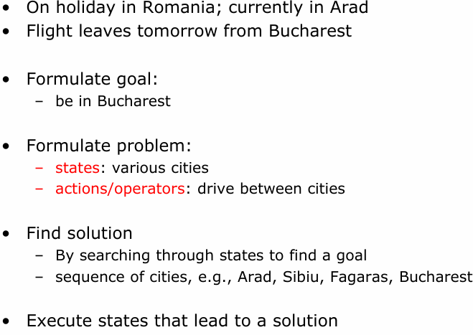
Example: Traveling in Romania

Slide 5
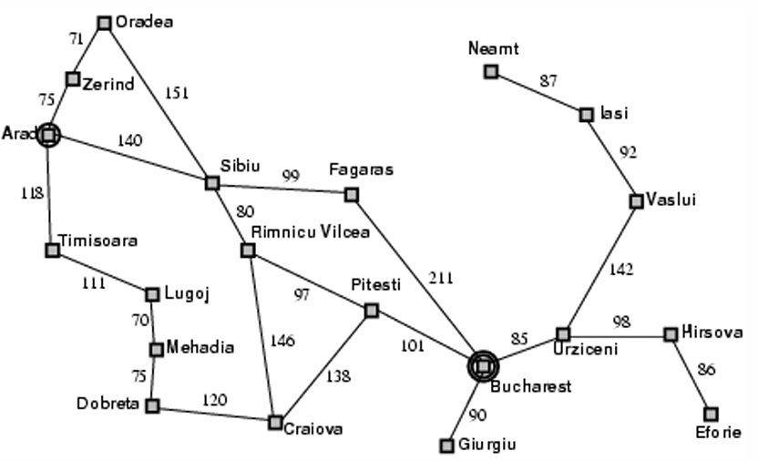
Example: Traveling in Romania

Slide 6


State-Space Problem Formulation

Slide 7

State-Space Problem Formulation

Slide 8

State-Space Problem Formulation

Slide 9

State-Space Problem Formulation

Slide 10

State-Space Problem Formulation

Slide 11
State-Space Problem Formulation

Slide 12
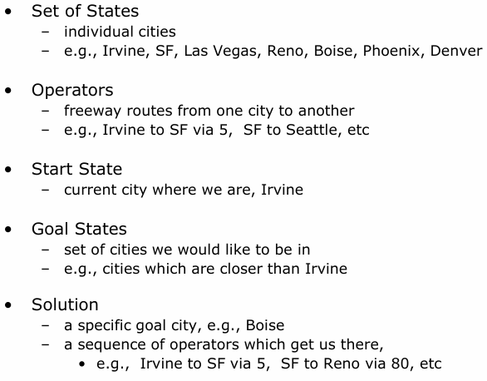
Example: Formulating the Navigation Problem

Slide 13
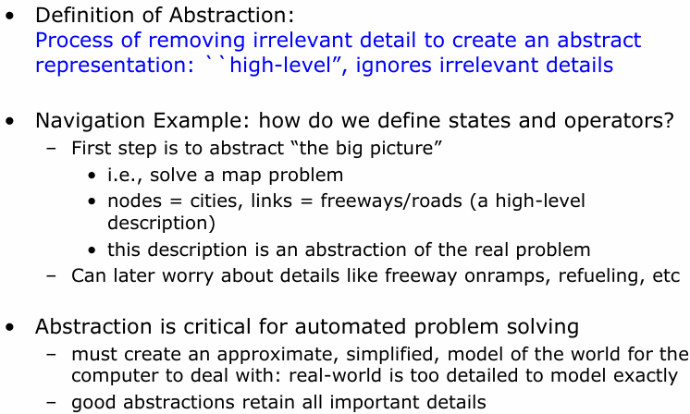
Abstraction

Slide 14
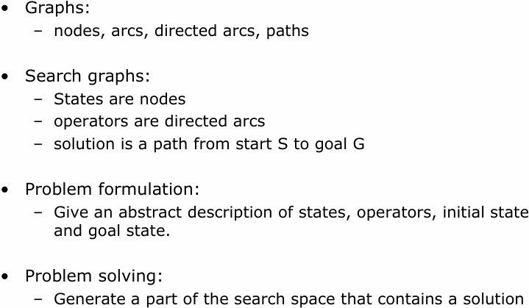
The State-Space Graph

Slide 15
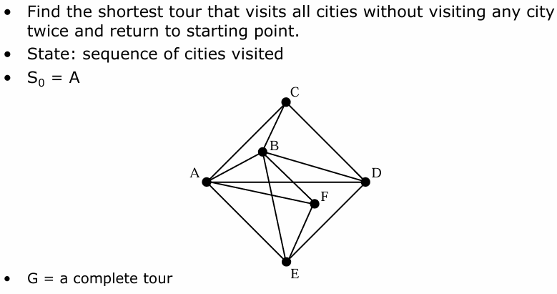
Example: The Traveling Salesman Problem

Slide 16
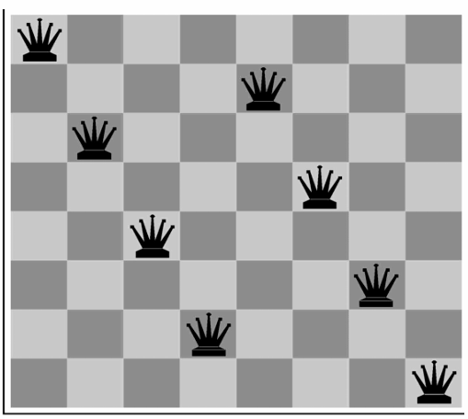
Example: 8-queens Problem

Slide 17
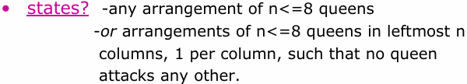
State-Space Problem Formulation

Slide 18
State-Space Problem Formulation

Slide 19

State-Space Problem Formulation

Slide 20
State-Space Problem Formulation

Slide 21

State-Space Problem Formulation

Slide 22
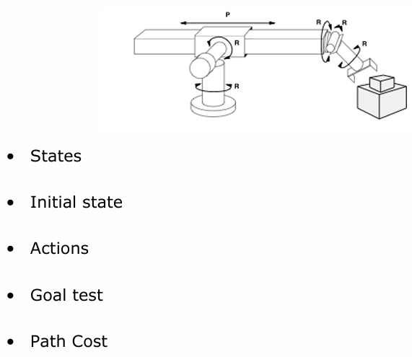
Example: Robot Assembly

Slide 23
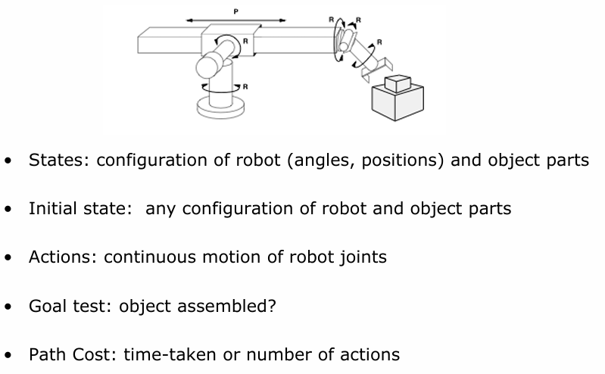
Example: Robot Assembly

Slide 24
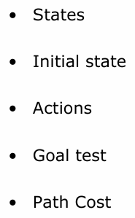
Learning a Spam Email Classifier

Slide 25
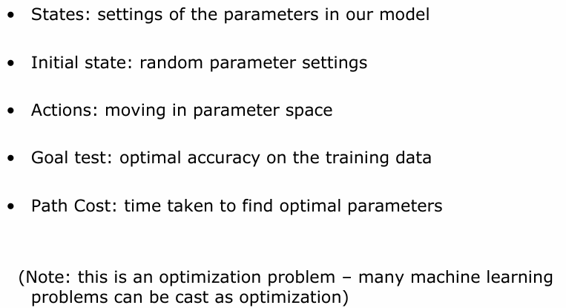
Learning a Spam Email Classifier

Slide 26
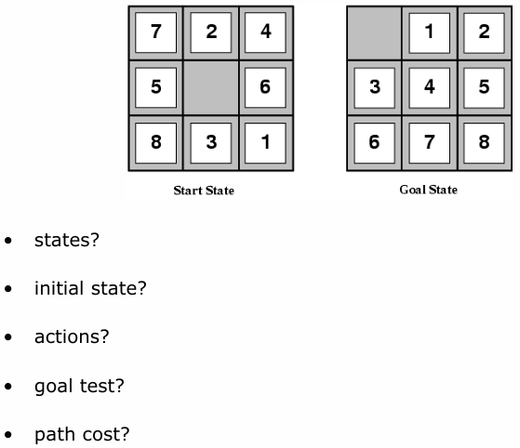
Example: 8-puzzle

Slide 27
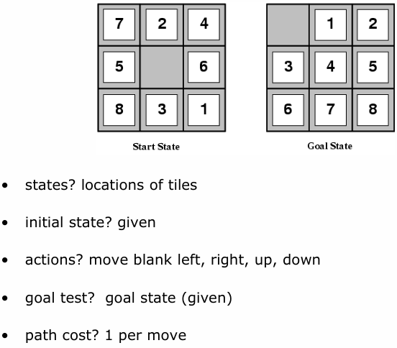
Example: 8-puzzle

Slide 28
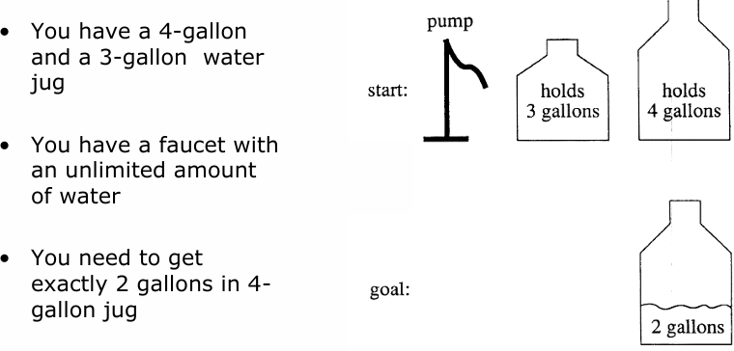
A Water Jug Problem

Slide 29
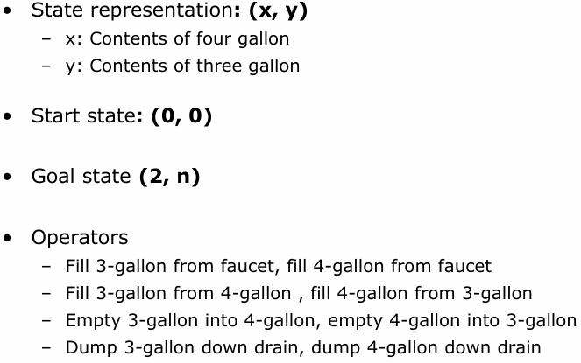
Puzzle-solving as Search

Slide 30
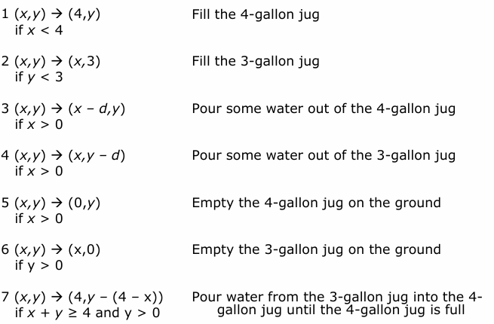
Production Rules for the Water Jug Problem

Slide 31
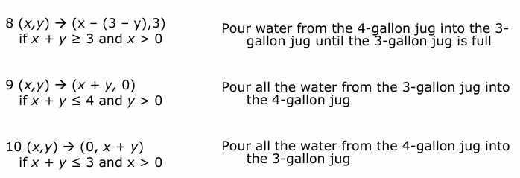
Production Rules for the Water Jug Problem

Slide 32
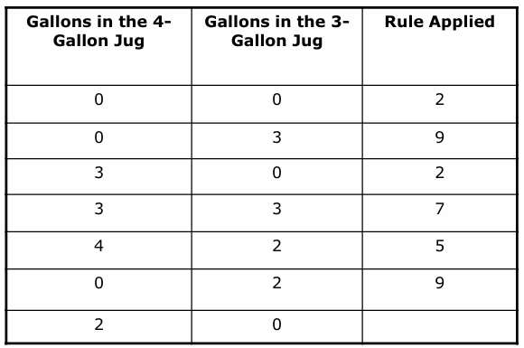
One Solution to the Water Jug Problem

Slide 33
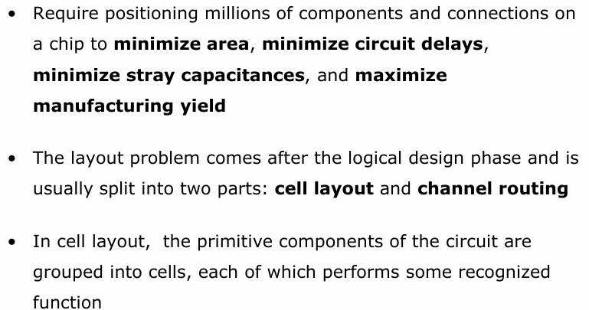
VLSI Layout Problem

Slide 34
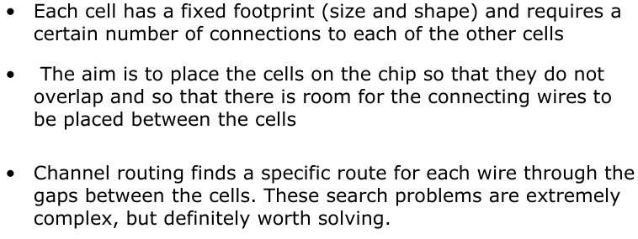
VLSI Layout Problem (Cont’d)

Slide 35
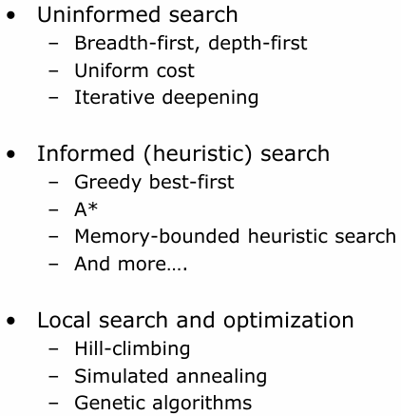
Next Topics

Slide 36
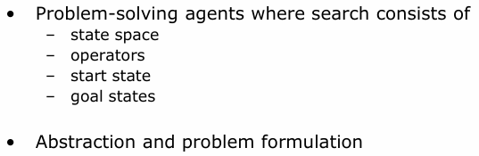
Summary

